Slide 2

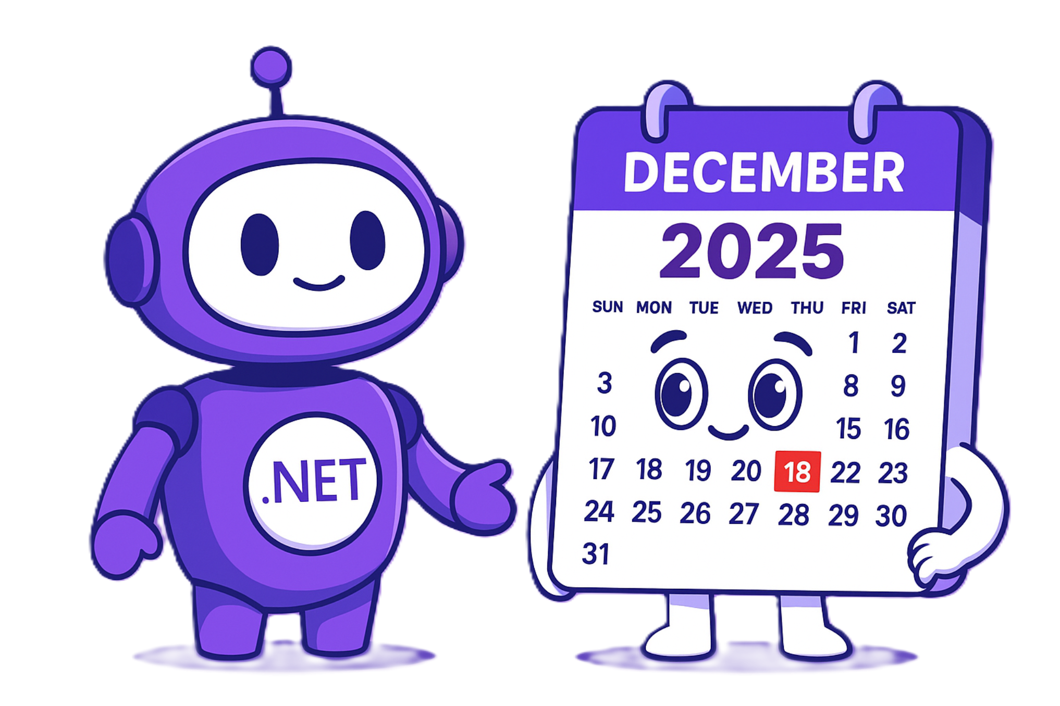
.NET Conf 2025 – Ukraine
Vladislav Antonyuk
Rostyslav Skrypnik

Slide 3
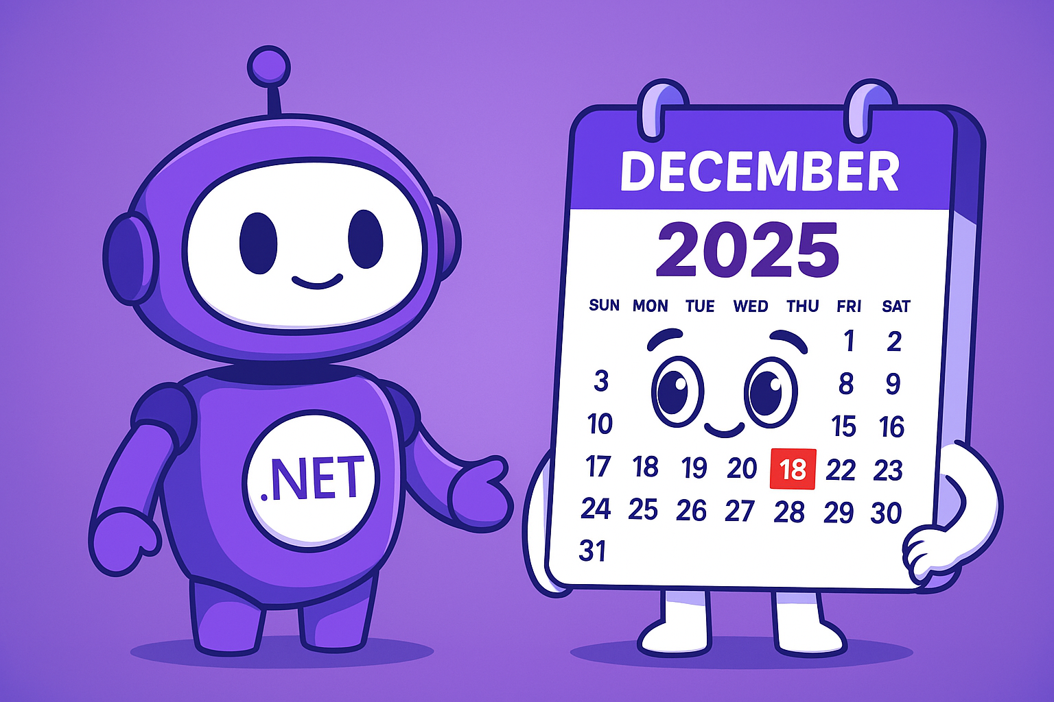
AI-Friendly Calendar!
AI Scheduling Assistant
Event Management
Cloud Sync
Multi-Platform Support
Notes:
AICalendar is a cross-platform AI-powered calendar application built with .NET MAUI and Blazor. It helps users efficiently manage their schedules, appointments, and events with intelligent features and a modern user experience.

Slide 4
.NET 10
File base app
https://devblogs.microsoft.com/dotnet/announcing-dotnet-10/

Slide 5
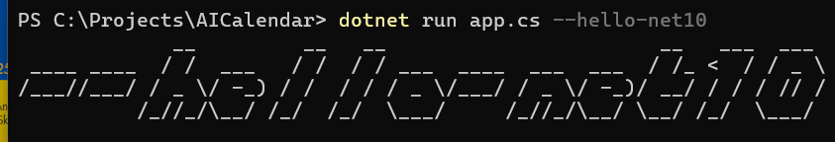
.NET 10 – file base app
#:package Colorful.Console@1.2.15 Colorful.Console.WriteAscii(args[0]); dotnet run app.cs | #:sdk Microsoft.NET.Sdk.Web #:sdk Aspire.AppHost.Sdk@9.4.1 #:property TargetFramework=net10.0 #:property LangVersion=preview #:package Aspire.Hosting.AppHost@9.4.1 #:package Colorful.Console@1.2.15 Colorful.Console.WriteAscii(args[0]);

Slide 6
.NET 10
File base app
https://devblogs.microsoft.com/dotnet/announcing-dotnet-10/

Slide 7
C# 14
Extension members
Null-conditional assignment
nameof supports unbound generic types
More implicit conversions for Span<T> and ReadOnlySpan<T>
Modifiers on simple lambda parameters
field backed properties
partial events and constructors
user-defined compound assignment operators
Notes:
This reduces the need for explicit .AsSpan()

Slide 8
C# 14 – Extension members
public static class Enumerable { // Extension block extension<TSource>(IEnumerable<TSource> source) // extension members for IEnumerable<TSource> { // Extension property: public bool IsEmpty => !source.Any(); // Extension method: public IEnumerable<TSource> Where(Func<TSource, bool> predicate) { ... } } }
Notes:
In previous versions, C# already supported extensions, but they were limited to methods. Now, we can easily extend a type with properties, methods, events, and even introduce operators (except implicit and explicit operators).

Slide 9
C# 14 – Extension members
public static class Enumerable { // extension block, with a receiver type only extension<TSource>(IEnumerable<TSource>) // static extension members for IEnumerable<Source> { // static extension method: public static IEnumerable<TSource> Combine(IEnumerable<TSource> first, IEnumerable<TSource> second) { ... } // static extension property: public static IEnumerable<TSource> Identity => Enumerable.Empty<TSource>(); // static user defined operator: public static IEnumerable<TSource> operator + (IEnumerable<TSource> left, IEnumerable<TSource> right) => left.Concat(right); } }

Slide 10
C# 14 – Extension members
Before | After
public static Guid GetUserId(this ClaimsPrincipal claims) { Guid.TryParse(claims.GetObjectId(), out var currentUserId); return currentUserId; } | extension(ClaimsPrincipal claims) { public Guid GetUserId() { Guid.TryParse(claims.GetObjectId(), out var currentUserId); return currentUserId; } }

Slide 11
C# 14 – Null-conditional assignment
Before | After
public sealed class Account { public decimal Balance { get; set; } } public sealed class PaymentProccessor { public void Payout(Account? account, decimal amount) { if (account is not null) { account.Balance -= amount; } } } | public sealed class Account { public decimal Balance { get; set; } } public sealed class PaymentProccessor { public void Payout(Account? account, decimal amount) { account?.Balance -= amount; } }

Slide 12
C# 14 – nameof supports unbound generic types
You can pass an unbound generic type to nameof. Great for diagnostics, analyzers, and source generators.
Before | After
Console.WriteLine(nameof(List<int>)); // "List" Console.WriteLine(nameof(Dictionary<int, string>)); // "Dictionary" | Console.WriteLine(nameof(List<>)); // "List" Console.WriteLine(nameof(Dictionary<,>)); // "Dictionary"
Notes:
Beginning with C# 14, the argument to nameof can be an unbound generic type. For example, nameof(List<>) evaluates to List. In earlier versions of C#, only closed generic types, such as List<int>, could be used to return the List name.

Slide 13
C# 14 – the “field” keyword
Before | After
private string _msg; public string Message { get => _msg; set => _msg = value; } | public string Message { get; set => field = value; }

Slide 14
C# 14 – More partial members
In addition to partial methods/properties, you can define partial constructors and events with defining and implementing declarations.
Defining declarations | Implementing declarations
public partial class Widget { public partial Widget(string name); public partial event EventHandler? Started; } | public partial class Widget { private string _name; public partial Widget(string name) : this() { _name = name; } public partial event EventHandler? Started { add { /* add logic */ } remove { /* remove logic */ } } }

Slide 15
C# 14
Extension members
Null-conditional assignment
nameof supports unbound generic types
More implicit conversions for Span<T> and ReadOnlySpan<T>
Modifiers on simple lambda parameters
field backed properties
partial events and constructors
user-defined compound assignment operators
Notes:
This reduces the need for explicit .AsSpan()

Slide 16
ASP.NET CORE
Validation support in minimal APIs
Blazor — Add a Not Found page using the Blazor Router
Support for Server-Sent Events
app.MapGet("/notifications", (IRandomizerString randomizer, CancellationToken token) => { return TypedResults.ServerSentEvents(GetNotificationsAsync(randomizer, token), "notification"); async IAsyncEnumerable<NotificationEvent> GetNotificationsAsync( IRandomizerString randomizerString, [EnumeratorCancellation] CancellationToken cancellationToken) { while (!cancellationToken.IsCancellationRequested) { await Task.Delay(4000, cancellationToken); yield return new NotificationEvent(Guid.CreateVersion7(), randomizerString.Generate()); } } });

Slide 17
.NET MAUI 10
Aspire integration
Android 16/iOS 26 Support
.NET MAUI Support Policy – https://dotnet.microsoft.com/en-us/platform/support/policy/maui
Focus on quality
CollectionView/CarouselView enhancements
New APIs: Shadows, Switch OffColor, and more
MessagingCenter is removed! Again!
ListView, TableView and Cells deprecated
Performance improvements
MediaPicker modernization
Nullable DatePicker and Nullable TimePicker
Editor and Entry on Android support SelectionChanged event
And More... https://learn.microsoft.com/en-us/dotnet/maui/whats-new/dotnet-10

Slide 18
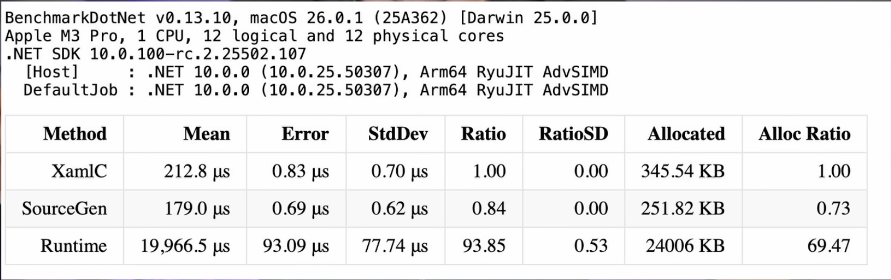
.NET MAUI 10
XAML Source Generation

Slide 19
.NET MAUI 10
XAML Global Namespaces
XAML Implicit Namespaces
Before | After
<ContentPage xmlns="http://schemas.microsoft.com/dotnet/2021/maui" xmlns:x="http://schemas.microsoft.com/winfx/2009/xaml" xmlns:models="clr-namespace:MyApp.Models" xmlns:controls="clr-namespace:MyApp.Controls" x:Class="MyApp.MainPage"> <controls:TagView x:DataType="models:Tag" /> </ContentPage> | <ContentPage x:Class="MyApp.MainPage"> <TagView x:DataType="Tag" /> </ContentPage>

Slide 20
EntityFramework Core
Support LeftJoin and RightJoin operator
JSON type
Before | After
var query = students .GroupJoin( departments, student => student.DepartmentID, department => department.ID, (student, departmentList)=> new{ student, subgroup = departmentList }) .SelectMany( joinedSet => joinedSet.subgroup.DefaultIfEmpty(), (student, department) => new { student.student.FirstName, student.student.LastName, Department = department.Name ?? "[NONE]" }); | var query = students .LeftJoin( departments, student => student.DepartmentID, department => department.ID, (student, department) => new { student.FirstName, student.LastName, Department = department.Name ?? "[NONE]" });

Slide 21

Templates
https://www.nuget.org/packages/VladislavAntonyuk.DotNetTemplates

Slide 22
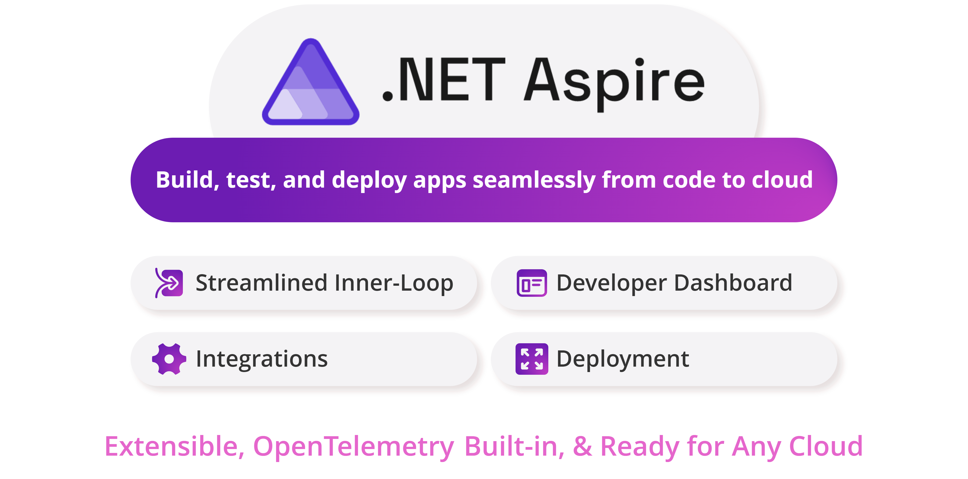
Overview of ASPIRE

Slide 23
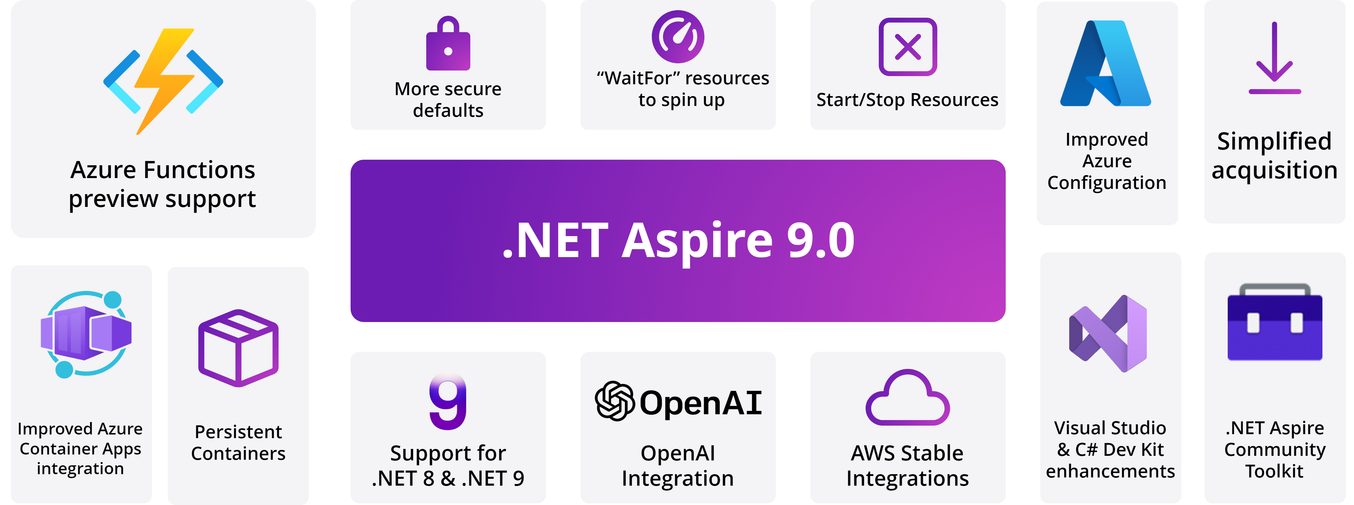
Overview of ASPIRE

Slide 24
Visual Studio 2026
AI built into the IDE
Insiders Channel
Performance improvements
UI refresh
Editor and productivity updates
Copilot context actions
BenchmarkDotNet template
Hot Reload improvements for Razor
Notes:
GetUserHandler

Slide 25
Visual Studio 2026 – GitHub Copilot Improvements
Bring your own model to chat (custom LLMs via API keys).
Adaptive paste: Copilot adjusts pasted code to fit context.
Copilot actions in context menu (explain, optimize, comment, test, add to chat).
“Did you mean?” Copilot-powered search suggestions.
Mermaid chart rendering in Markdown editor and Copilot Chat.
Copilot URL context: paste a URL in chat to pull in page content.
Better Copilot responses: improved code search, external symbol awareness, and line number accuracy.

Slide 26
Visual Studio 2026 – IDE & UI
Code coverage now available in Community and Professional editions.
New look and feel: Fluent UI design, new themes, and iconography.
Modern settings experience: streamlined, user-friendly settings UI.

Slide 27
Visual Studio 2026 – Debugging & Diagnostics
CMake diagnostics: native support for CPU, events, and file IO tools (with Copilot insights).
.NET Allocation Tool: Copilot assistance for zero-length array allocations.
Inline post-return values with Copilot insights in the debugger.
Search in Text Visualizer (Ctrl+F in string visualizer).
New Profiler launch experience with Copilot recommendations.
Profiler Copilot Agent: AI-driven performance analysis and suggestions.

Slide 28

AI Profiler
An AI-assisted profiler that goes beyond showing performance bottlenecks — it uses real traces and benchmarks and can suggest prioritized fixes. Also supports natural-language queries to guide profiling.

Slide 29
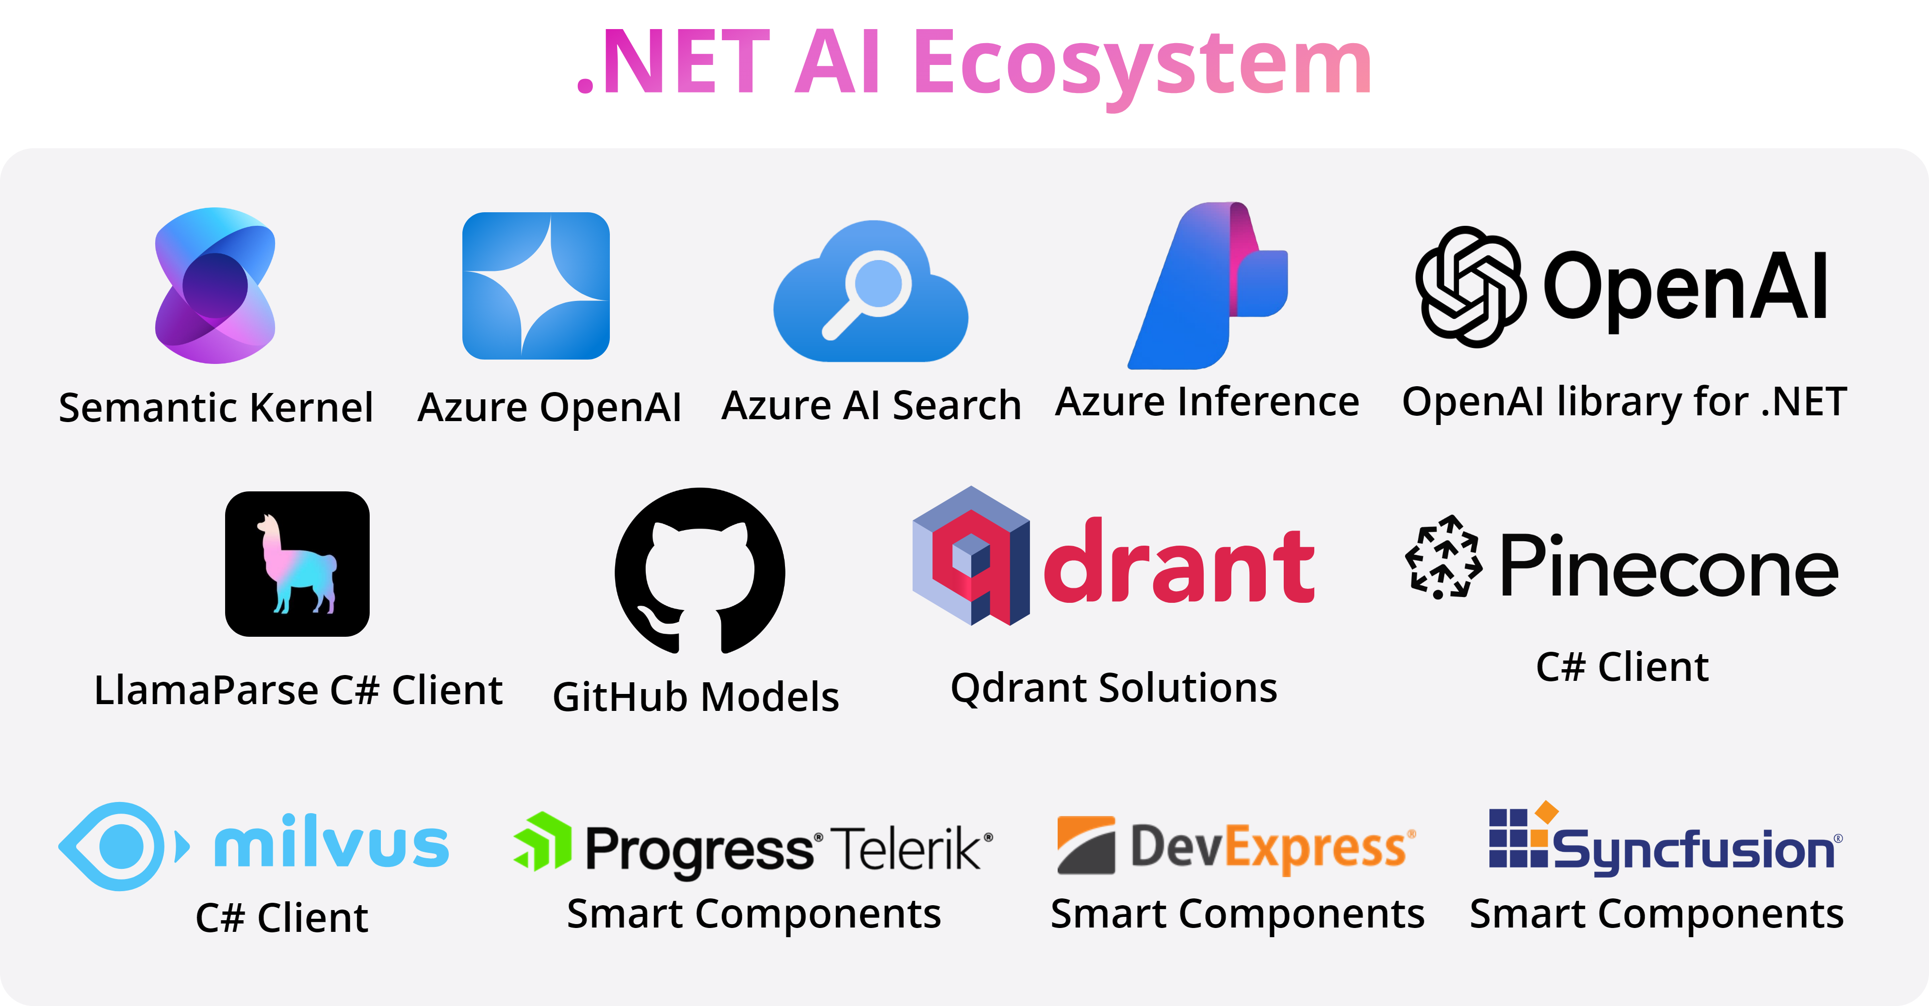
Artificial Intelligence and .NET

Slide 30
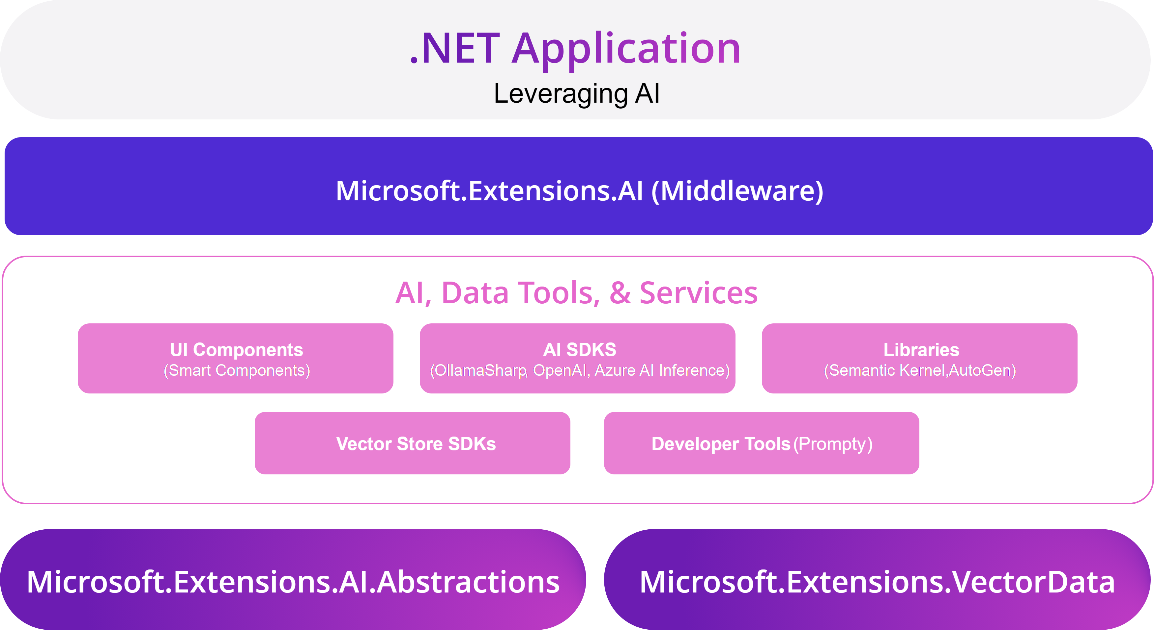
Artificial Intelligence and .NET

Slide 31
MCP, AI, .NET
Your computer
MCP Protocol
MCP Server A
Local
Data Source A
Internet
Host
(VS Code, IDEs)
Client
(GitHub Copilot)
MCP Server B
MCP Protocol
Web APIs
Local
Data Source B
MCP Protocol (SSE)
Remote
Remote Server
Web APIs
Remote
Service C
Notes:
MCP C# SDK

Slide 32
AI Agents
An artificial intelligence (AI) agent is a software program that can interact with its environment, collect data, and use that data to perform self-directed tasks that meet predetermined goals.
AI agents work by simplifying and automating complex tasks. Most autonomous agents follow a specific workflow when performing assigned tasks.
Determine goals
Acquire information
Implement tasks

Slide 33
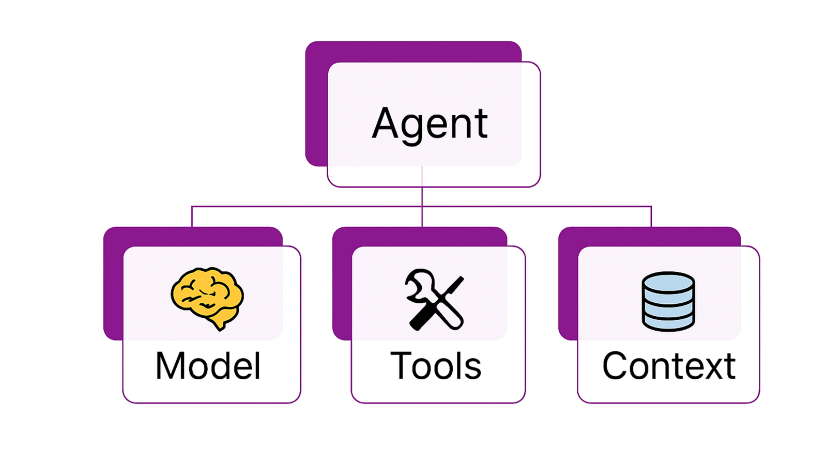
AI Agents

Slide 34
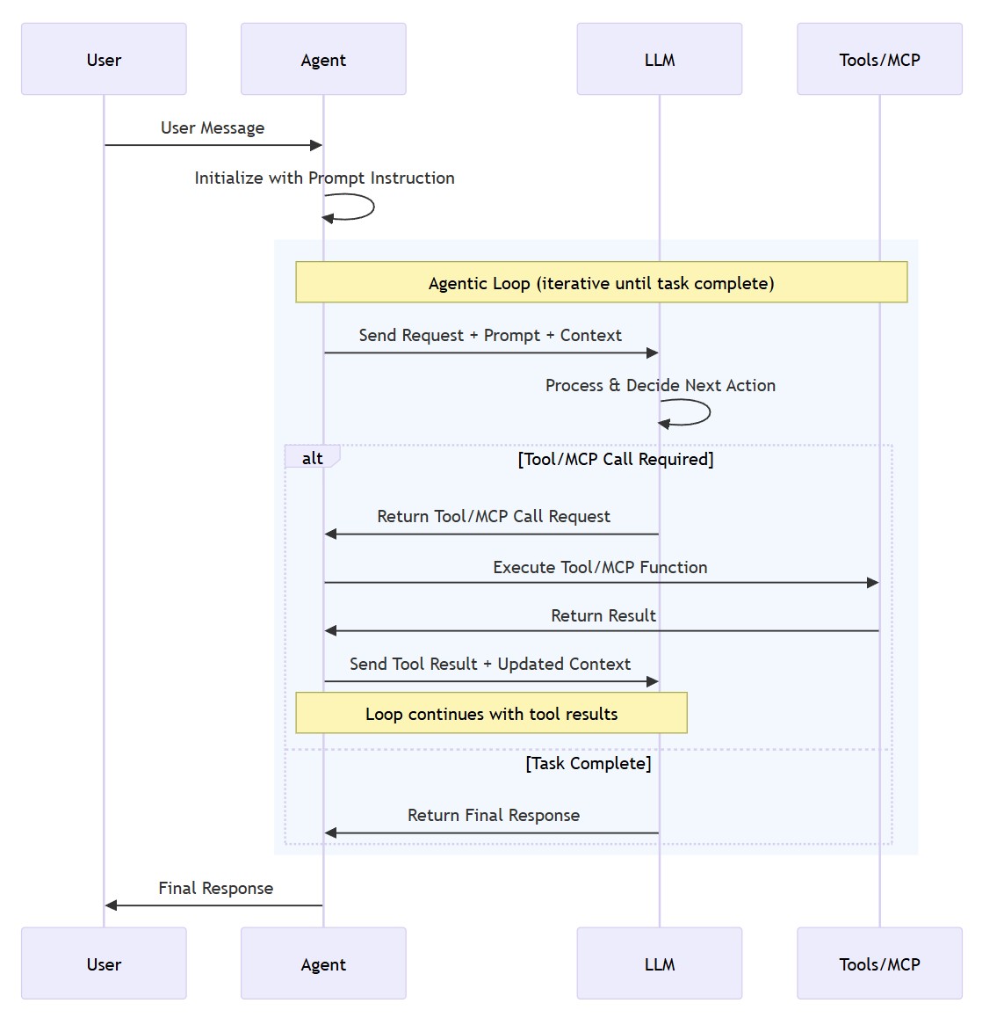
AI Agents
Notes:
Microsoft Agent Framework

Slide 35
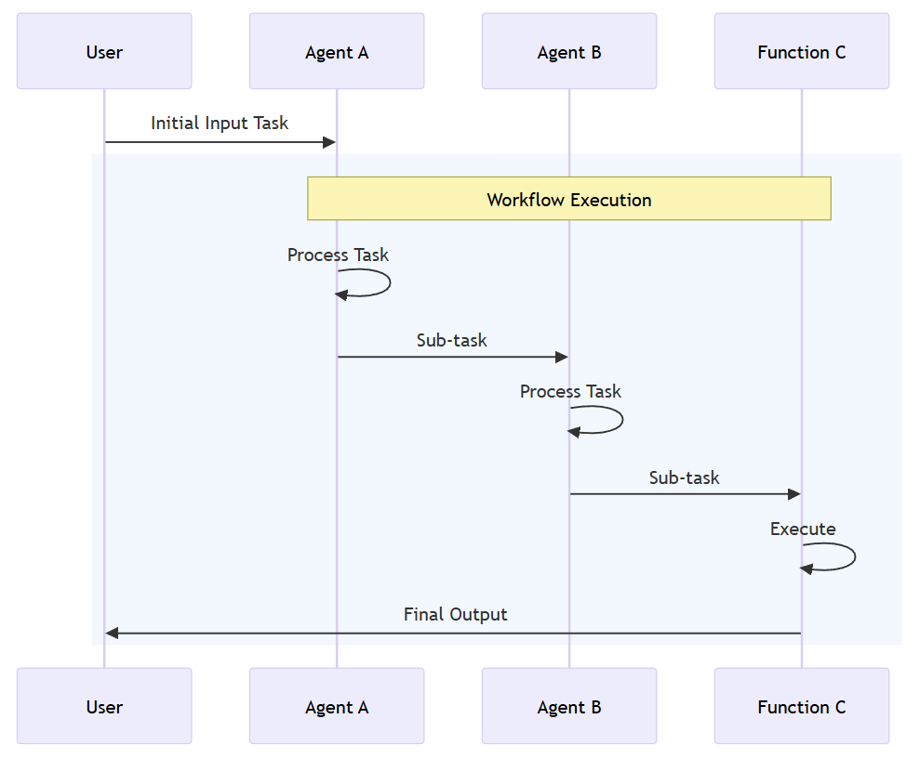
AI Agents – Workflow
A workflow can express a predefined sequence of operations that can include AI agents as components while maintaining consistency and reliability. Workflows are designed to handle complex and long-running processes that might involve multiple agents, human interactions, and integrations with external systems.

Slide 36
AI Evaluation
📦 Microsoft.Extensions.AI.Evaluation – Defines the core abstractions and types for supporting evaluation.
📦 Microsoft.Extensions.AI.Evaluation.NLP - Contains evaluators that evaluate the similarity of an LLM's response text to one or more reference responses using natural language processing (NLP) metrics. These evaluators aren't LLM or AI-based; they use traditional NLP techniques such as text tokenization and n-gram analysis to evaluate text similarity.
📦 Microsoft.Extensions.AI.Evaluation.Quality – Contains evaluators that assess the quality of LLM responses in an app according to metrics such as relevance and completeness. These evaluators use the LLM directly to perform evaluations.
📦 Microsoft.Extensions.AI.Evaluation.Safety – Contains evaluators, such as the ProtectedMaterialEvaluator and ContentHarmEvaluator, that use the Azure AI Foundry evaluation service to perform evaluations.
📦 Microsoft.Extensions.AI.Evaluation.Reporting – Contains support for caching LLM responses, storing the results of evaluations, and generating reports from that data.
📦 Microsoft.Extensions.AI.Evaluation.Reporting.Azure – Supports the reporting library with an implementation for caching LLM responses and storing the evaluation results in an Azure Storage container.
📦 Microsoft.Extensions.AI.Evaluation.Console – A command-line tool for generating reports and managing evaluation data.

Slide 37
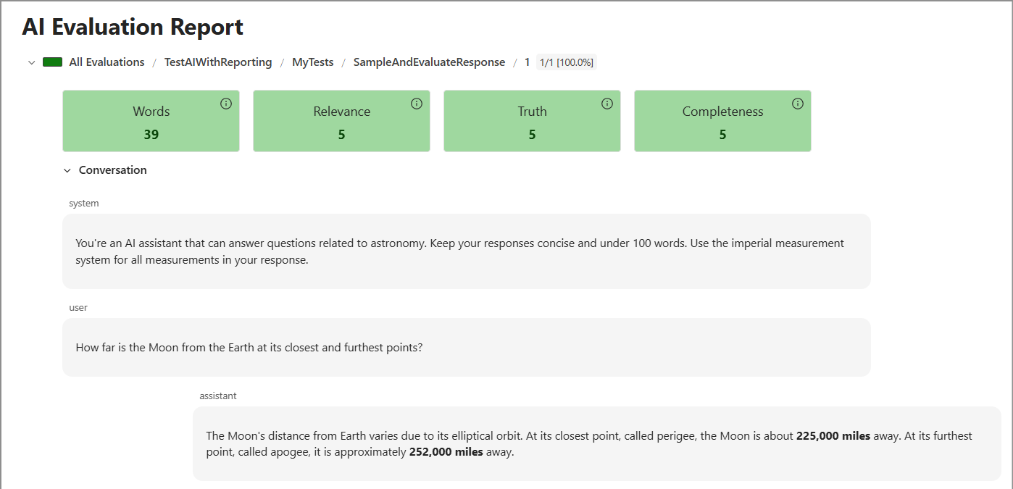
AI Evaluation

Slide 38
SignalR
text

Slide 39
Links and Samples
.NET 9 Overview
.NET Aspire docs
.NET AI Overview

